Slide 1
Explorer 2023
Pyportal – Moisture sensor usage

Slide 2
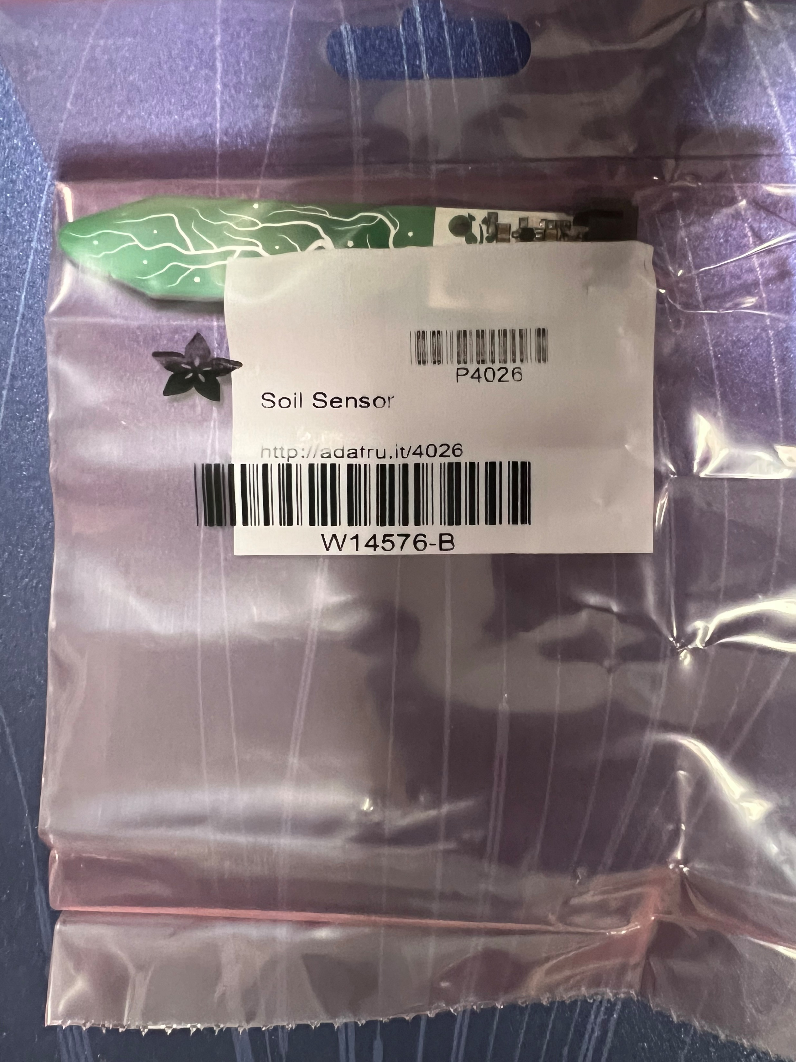
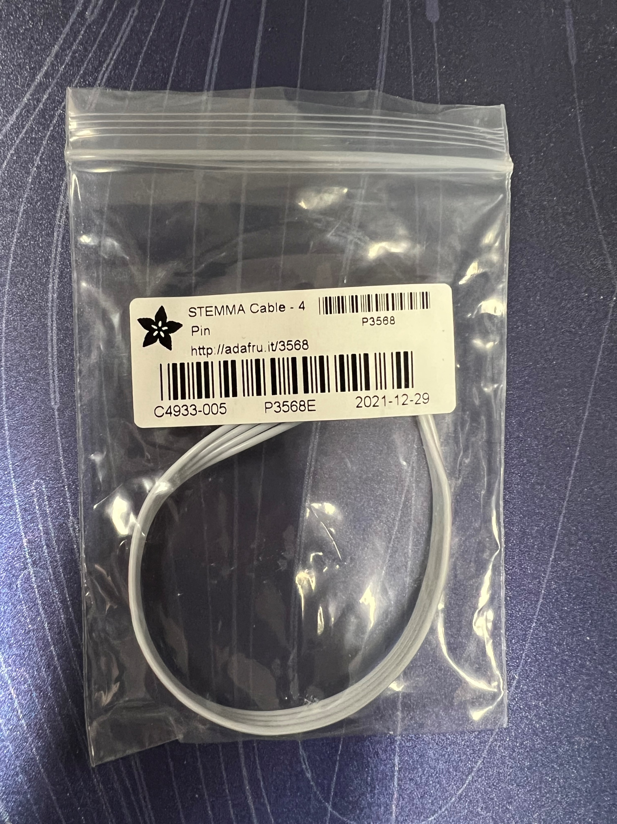
Components
Cable to connect moisture sensor board with PyPortal
Moisture
Temperature
Moisture Sensor board

Slide 3
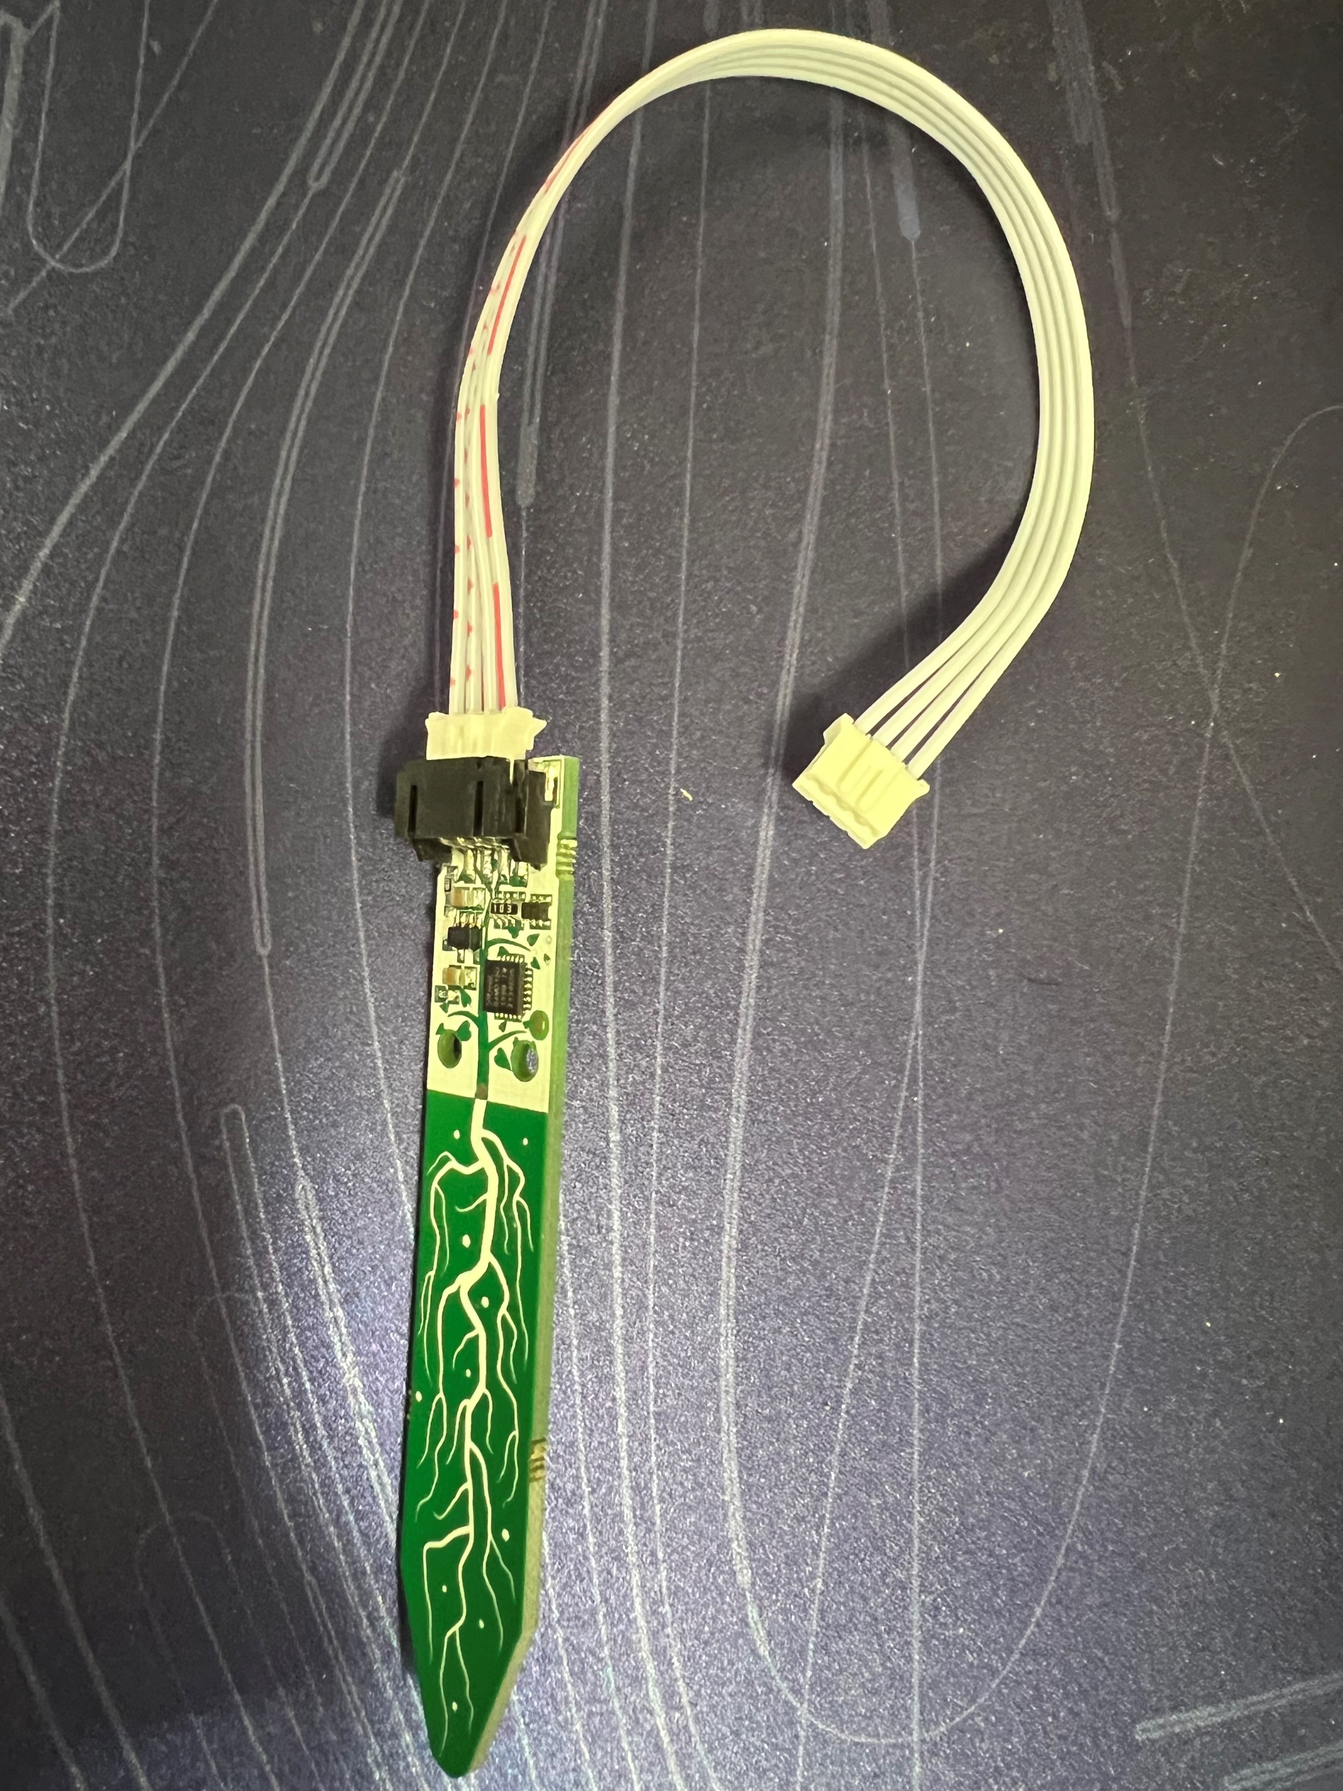
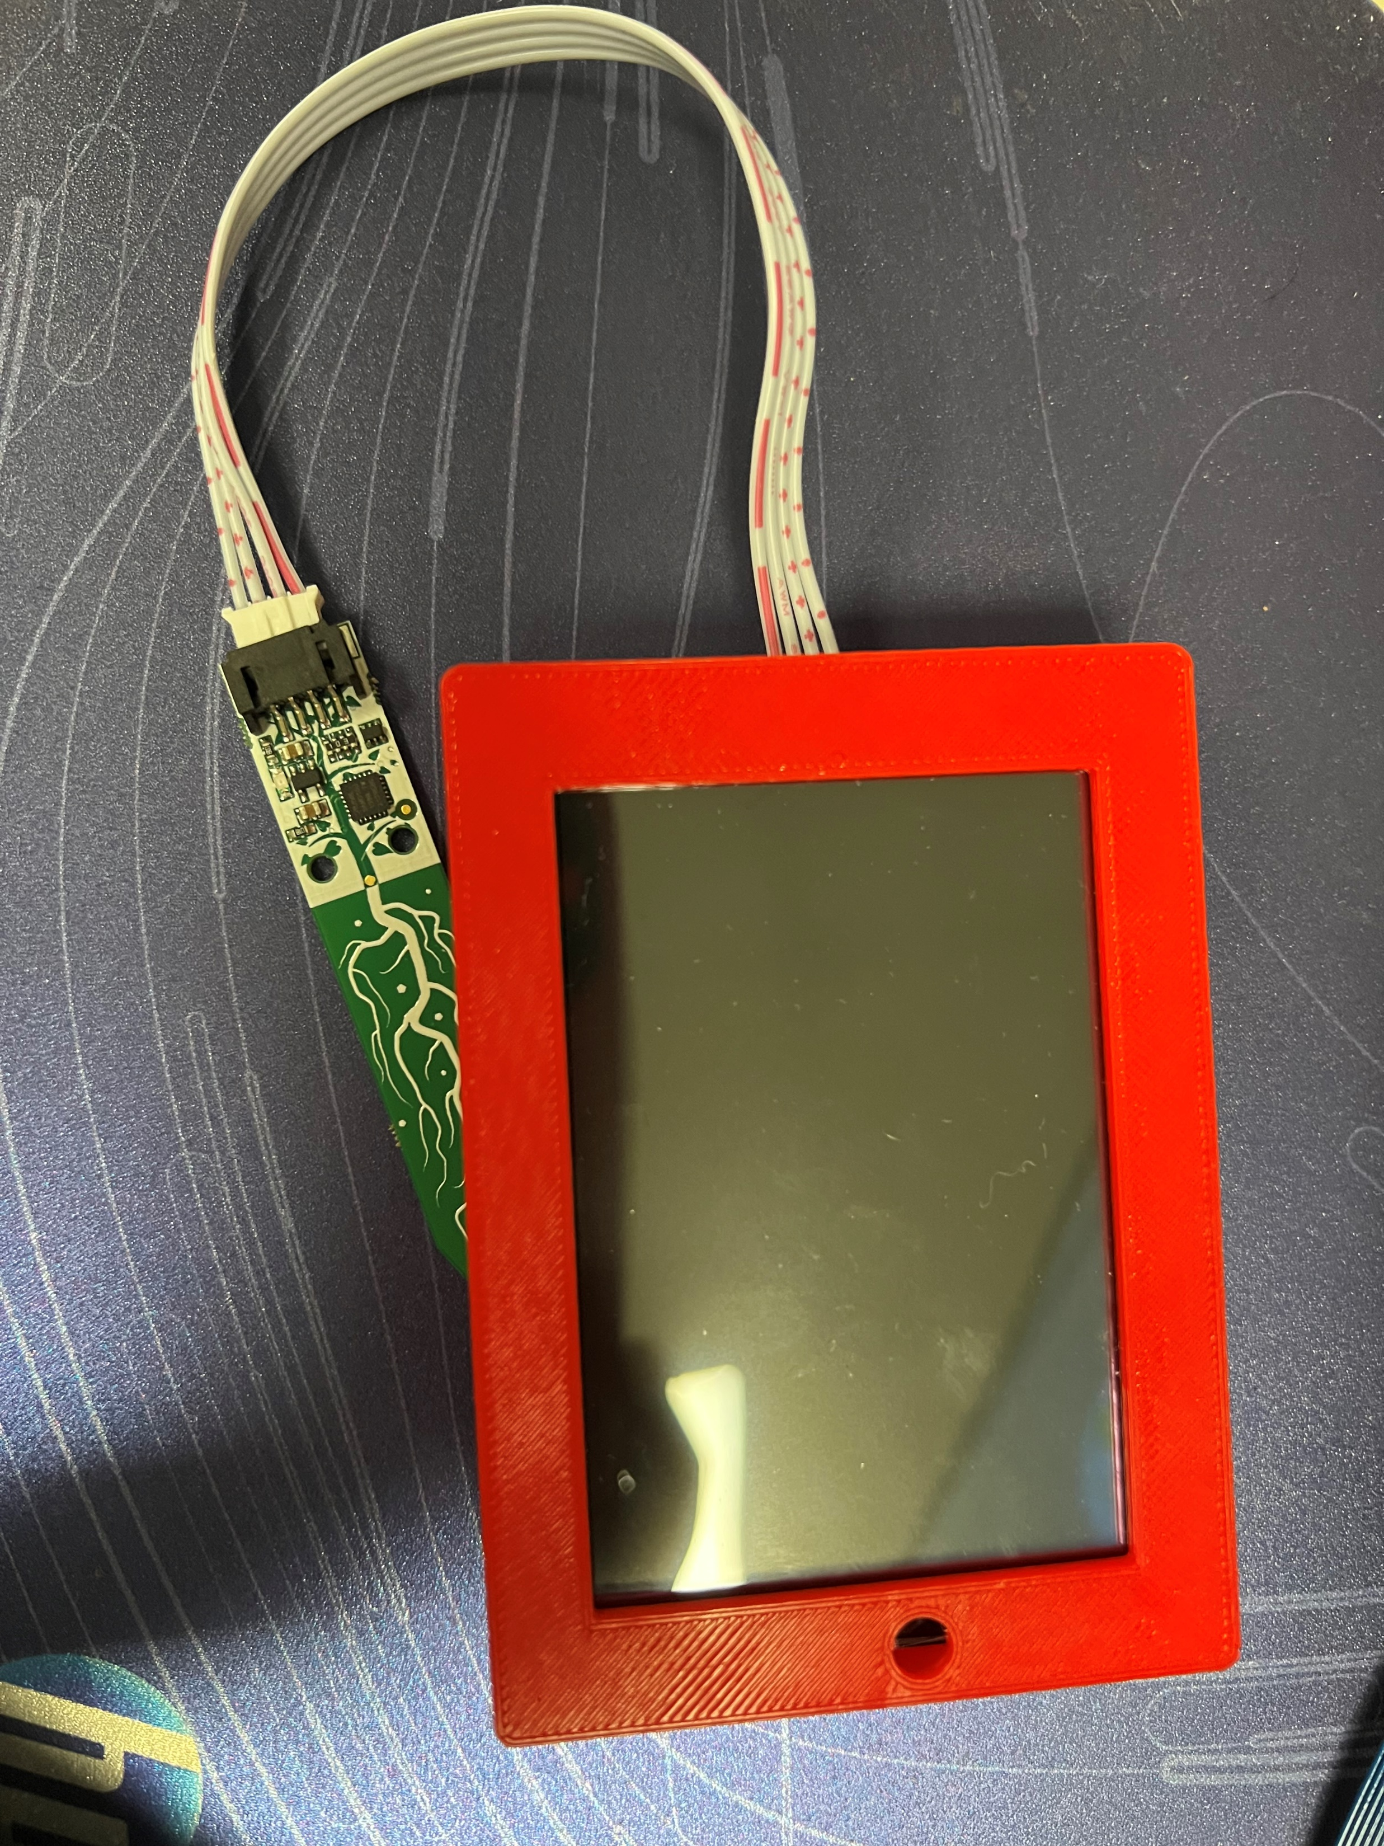
Connections
Big white connector connects to middle connector of PyPortal
Connect one end with the board

Slide 4
Steps
Connect the Moisture sensor board with pyportal as seen in the previous slides
Connect the pyportal to the computer using USB cable
Make sure that the secret.py has the correct ssid & password
Save the existing code.py on your PC
Then replace it with the new code.py on Pyportal
Observe the screen to match the sample output
Visit https://io.adafruit.com/ to check the feed update

Slide 5
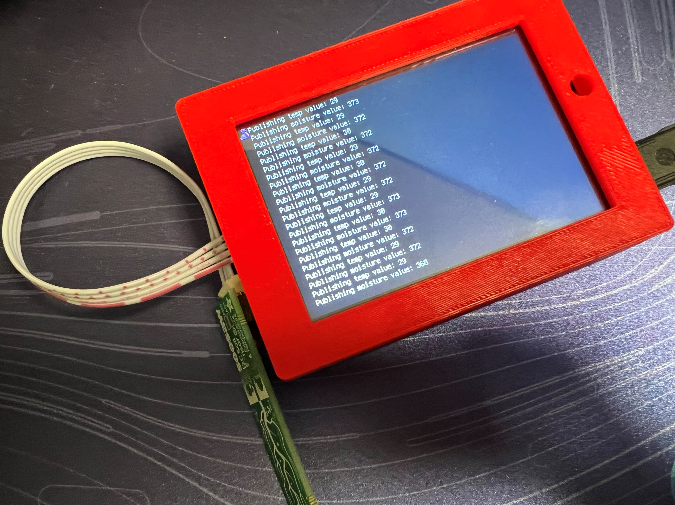
Sample output

Slide 6
Testing
You can touch edge of the board
Observe the changes in the feed

Slide 7
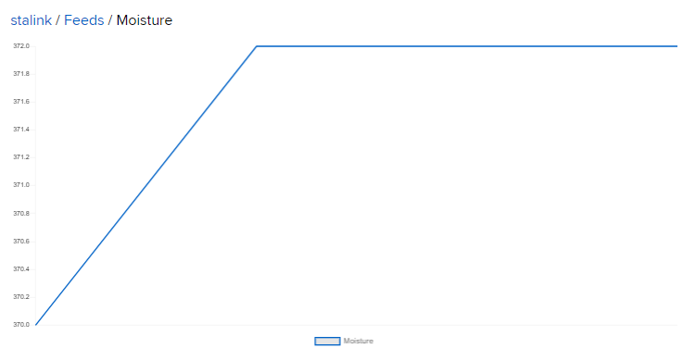
Moisture

Slide 8
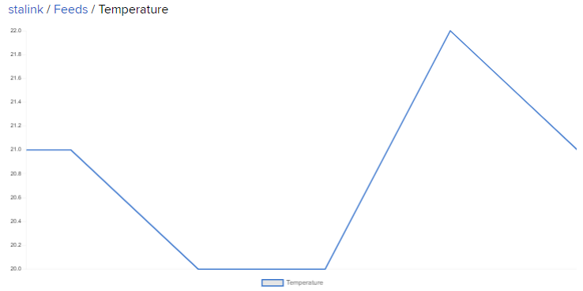
Temperature

